Slide 1

Department of Electrical, Electronics and Communication Engineering GITAM Deemed to be University, Bengaluru
19EEC491 Project Phase I
Remote Monitoring for Automated Cold Storage Facility Management System
Project Team:
Y V KARTHIK REDDY-322010401010
N VINOD KUMAR-322010401012
K L NARASIMHA-322010401029
G BHARATH KUMAR REDDY-322010401047
Project Guide:
Dr.C Kamalanathan
Associate Professor/EECE

Slide 2
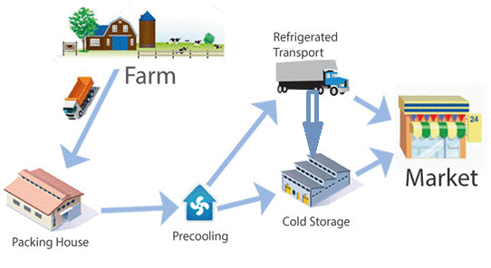
Introduction
The intake of the perishable fruits and vegetables (FVs) in the human diet can contribute to reduce the risk of some chronic diseases.
One of the key factors contributing to this high loss rate is inability to gauge vital ambient environmental parameters in cold storage.
The proposed system has a real-time intelligent monitoring and notification system (RT-IMNS)

Slide 3
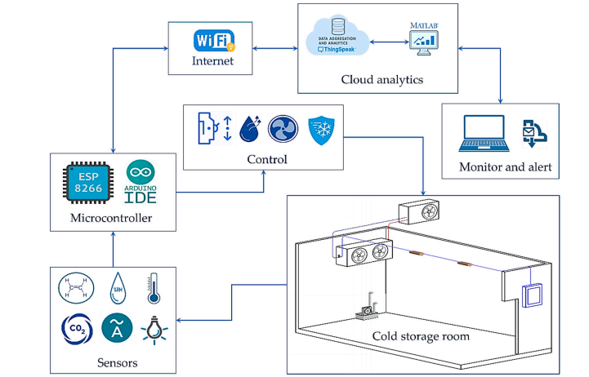
Banked on an Internet of Things (IoT)- enabled approach for real-time monitoring of temperature, relative humidity and concentration of gas using respective cold storage
Block Diagram:.

Slide 4
LITERATURE SURVEY

Slide 5
Ref No. | Title of paper | Abstract | Outcome | Methodology | Research gap
1 | Smart Cold Storage and Inventory Monitoring System | The perishable goods are often required to travel thousands of miles by land, air, water transport facilities to reach their final destination. It creates a lot of pressure on tracking the companies using the cold storage supporters for the distribution of the food and maintain a certain temperature during the entire journey. Our system enables endless real time monitoring. It helps in controlling the losses which occur for business. As per the research India has 7645 cold storage facilities, out of these about 68% is used to store vegetables. And remaining 32% is used for storing other commodities The proposed cold storage system Temperature and Humidity sensor, Ultrasonic sensor, Wi-Fi enabled microcontroller board and Mobile application are used. | The implementation of an IoT -based cold storage and Inventory monitoring system leads to the optimum utilization of space and resources. It helps to track the usage pattern and power consumption of devices, minimize wastage, detect anomalies within the facility, and monitor and control the intensity of light as per the changes in daylight. An IoT -enabled monitoring solution brings terrific value to businesses and enhances profitability. To know more about how IoT -enabled cold storage and inventory monitoring helps to increase your ROI, please talk to our experts. | Integrating IoT, Node MCU, and IBM Watson IOT for Real-time Monitoring, Control, and Alerts for Cold Storage Management System | Integration of Additional Sensors: While the system currently incorporates sensors for temperature, humidity, and pressure, there might be other critical parameters that can affect the quality of stored goods, such as gas levels (e.g., ethylene), light intensity, and air quality. Integrating additional sensors could provide a more comprehensive monitoring

Slide 6
Ref No. | Title of paper | Abstract | Outcome | Methodology | Research gap
1 | Design of a Smart Iot-Based Control System For Remotely Managing Cold Storage Facilities (2022) | Cold storage is deemed one of the main elements in food safety management to maintain food quality. The temperature, relative humidity (RH), CO2,C2H4 ,and Luminosity cold storage rooms (CSRs) should be carefully controlled to ensure food quality and safety during cold storage. These parameters affect the stored product quality, and the real-time sending of warnings is very important for early preemptive actionability against the risks that may cause damage to the components of the cold storage rooms. This research aimed to design and evaluate a IoT-BC system to remotely control, risk alert, and monitor the microclimate parameters, i.e., RH, temperature, CO2 , C2H4 , and light and some operating parameters | Maintaining high quality and ensuring food safety are extremely important. The present study presented a smart IoT-BC system that connects sensors, actuators, and related cold storage equipment for remote controlling, monitoring, and risk alerting to maintain food quality and components of cold storage facilities. This research recommend IoT-BC technology to manage cold storage facilities to maintain the high quality and safety of the stored food due to its positive impacts on the characteristics of stored fruits and the potential of remote control and monitoring of cold storage facilities. | Real-time Remote Monitoring and Control System for Cold Storage Using IoT, ThingSpeak, & MATLAB Analytics" | Scalability and Robustness: While the current system demonstrates the feasibility of real-time monitoring and control of a single cold storage room, there may be a need to explore how well the system can scale to handle multiple cold storage rooms in a larger facility or across different locations. Additionally, the robustness of the system under varying conditions, such as network connectivity issues or sensor failures, should be investigated.
2

Slide 7
Outcome of Literature Survey
Maintaining high quality and ensuring food safety are extremely important. The present study presented a smart IoT-BC system that connects sensors, actuators, and related cold storage equipment for remote controlling, monitoring, and risk alerting to maintain food quality and components of cold storage facilities.
As per the case study, the cloud-based IoT system to control and monitor the microclimate, i.e., RH, temperature, CO2, C2H4, and interior light for a commercial-sized CSR, to extend the shelf life a the quality of the date fruit.
IoT-BC technology to manage cold storage facilities to maintain the high quality and safety of the stored food due to its positive impacts on the characteristics of stored fruits and the potential of remote control and monitoring of cold storage facilities.

Slide 8
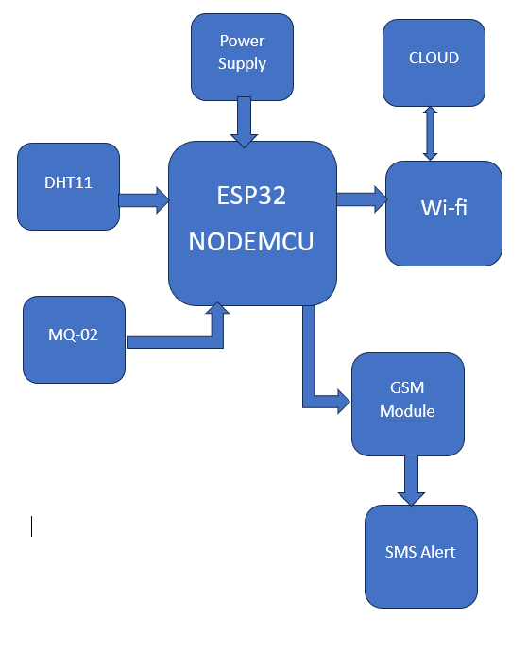
Block Diagram

Slide 9
Methodology
The project's objective is to develop a remote cold storage monitoring system using sensors, an ESP32 microcontroller, and a GSM module for preserving perishable goods.
Sensors like DHT11 and MQ-3 are connected and calibrated for accurate temperature, humidity, and gas readings.
Collected data is processed by the ESP32, and continuous monitoring against predefined thresholds ensures prompt breach detection.
A GSM module sends real-time SMS alerts when temperature or gas thresholds are exceeded, minimizing redundancy in alert notifications.
Data is securely stored and visualized using the ThingSpeak cloud platform, with security measures to restrict access to authorized users only.

Slide 10
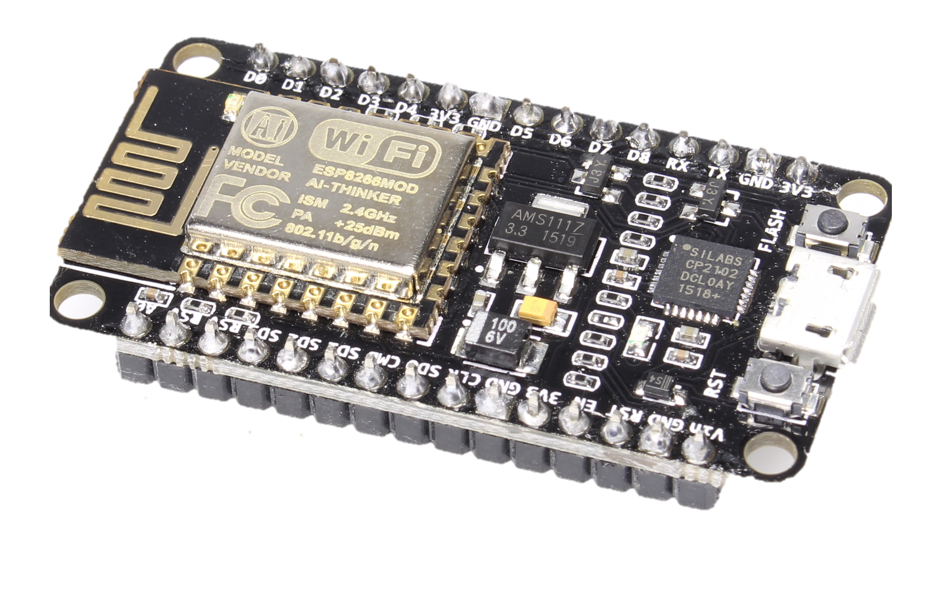
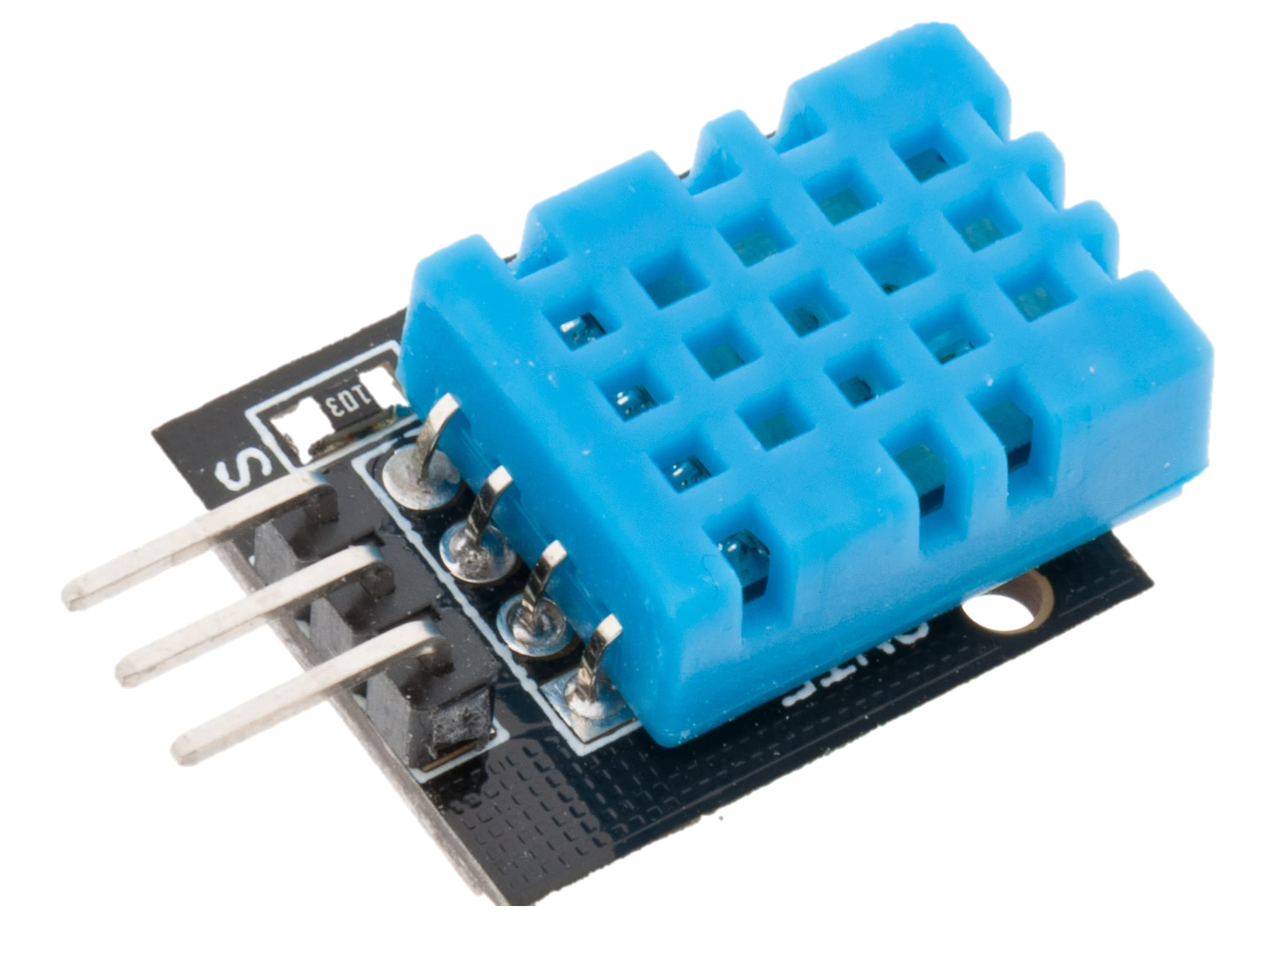
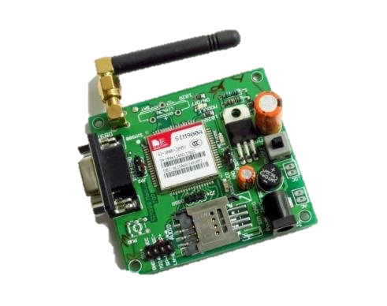
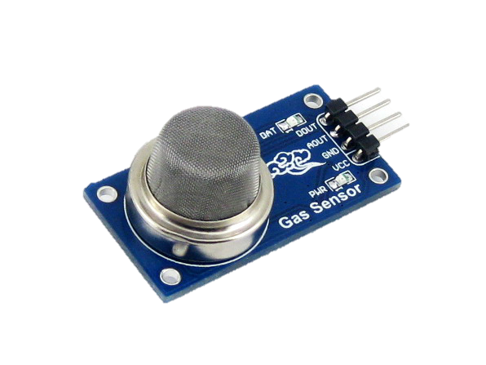
HARDWARE Used
ESP32(NodeMCU)
DHT11
MQ2
GSM Module

Slide 11


Software Used
Key features
Dashboards
Data Storage
SMS and Alerts

Slide 12
Objectives
To Develop the Real-Time Monitoring System for food storage
To Implement of IOT-Based Decision Support for risk monitoring

Slide 13
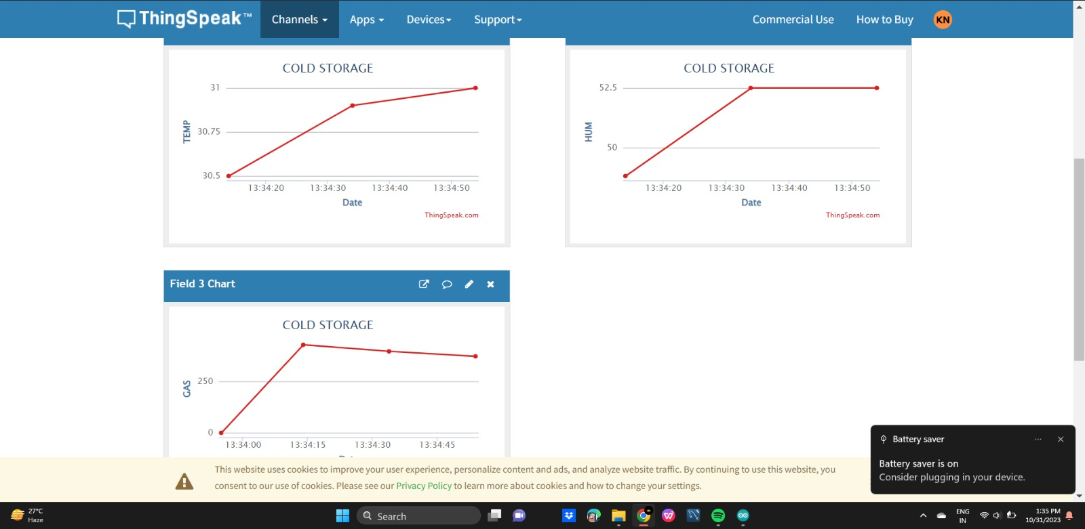
Results:
Parameters Visualization

Slide 14
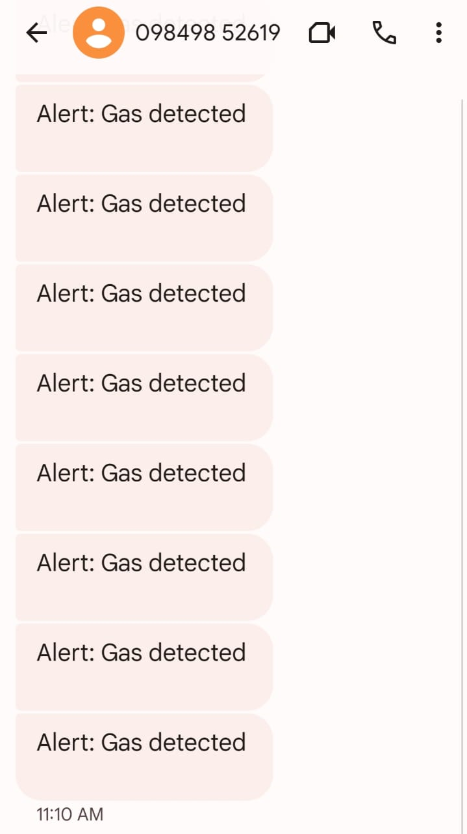
SMS Alert sent by GSM module

Slide 15
Applications:
Food Storage and Preservation
Pharmaceutical Storage
Cold Chain Management
Risk Mitigation

Slide 16
Conclusion:
Quality Assurance
Efficient Operations
Risk Prevention

Slide 17

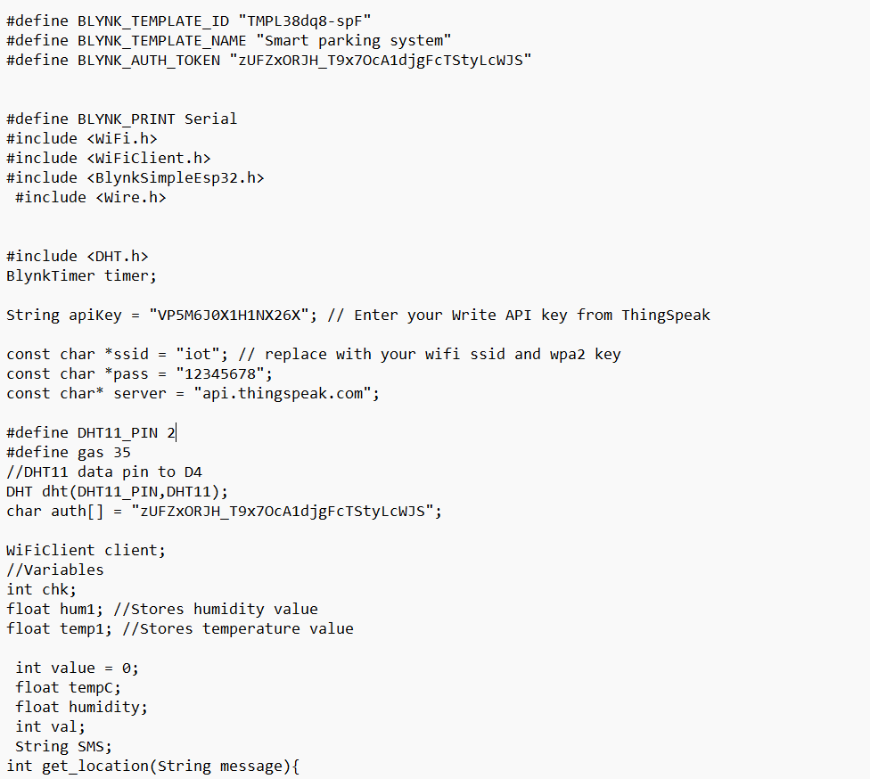
CODE

Slide 18
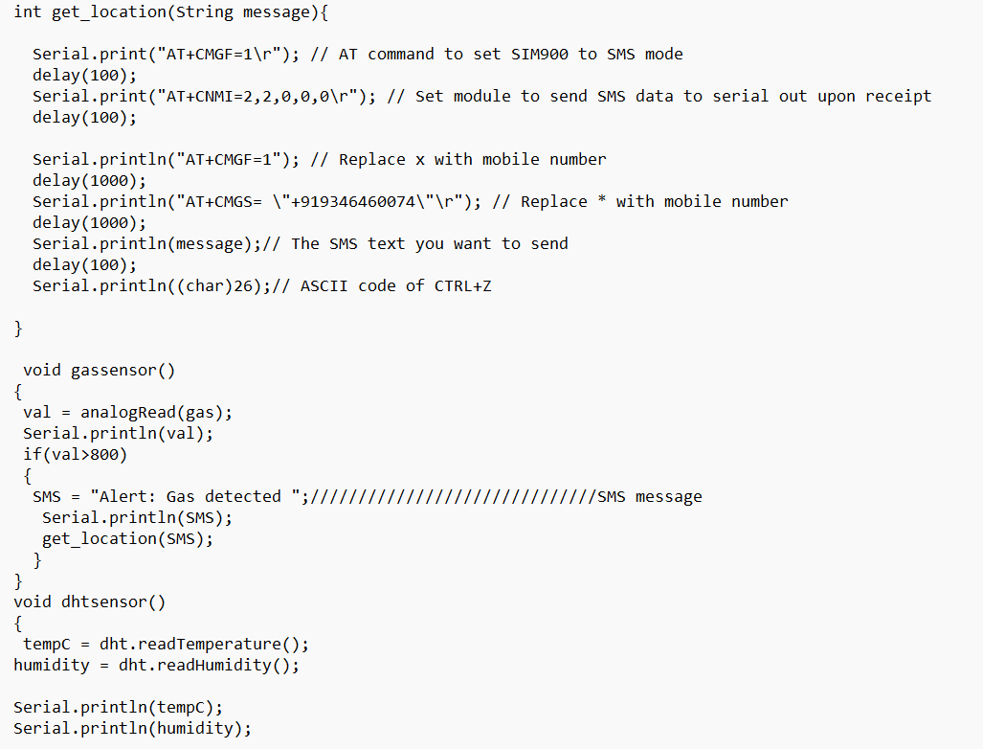

Slide 19
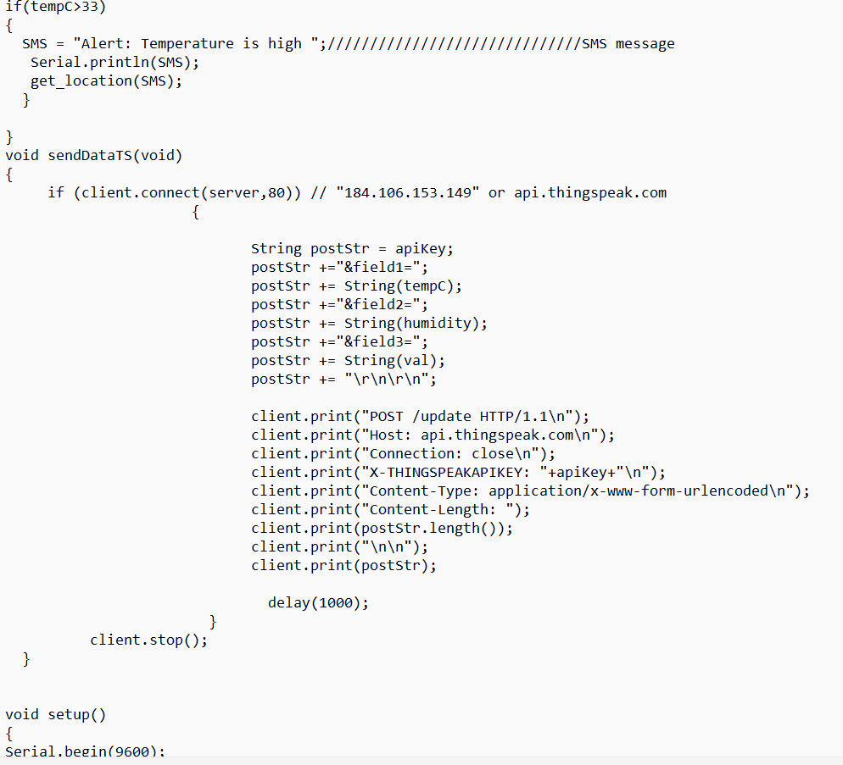
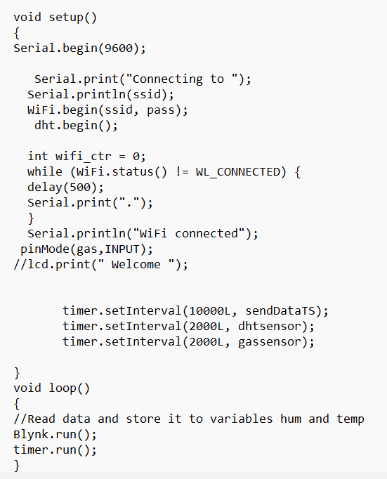

Slide 20
References
[1] Maged Mohammad, et al,(2022),”Design of a Smart IoT-Based Control System for Remotely Managing Cold Storage Facilities”,Sensors 2022, 22, 4680. https://doi.org/10.3390/s22134680
[2]Shraddha G Srivatsa; Karthik R M Bharadwaj; Sri Lavanya Alamuri; Mohammed M C Shanif; H S Shreenidhi,et al,(2021),”An IoT-based Real-time Intelligent Monitoring and Notification System of Cold Storage”,IEEE AccessDOI 10.1109/ACCESS.2021.3056672, IEEE Access
[3]Lydia , Leones Sherwin Vimalraj , Monisha , Murugan,et al,(2022),”Automated food grain monitoring system for warehouse using IOT” Measurement: Sensors.

Slide 21
Thank you!

